Slide 1

SE-3002 Software quality engineering
Part II-Software Testing
Software Testing
Lecture # 13,14, 15

Slide 2
Today’s Outline
Software testing
Testing levels
Testing strategies
Limitations of testing
Functional testing
Boundary value analysis
Notes:
https://classroom.google.com/u/1/c/Mjc1MTg1NDU1MDla

Slide 3
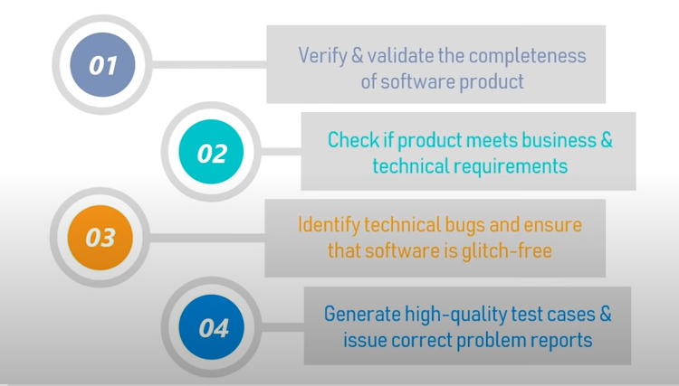
Software Testing objectives:

Slide 4
Testing
Testing is a critical element of software development life cycles
called software quality control or software quality assurance
basic goals: validation and verification
validation: are we building the right product?
verification: does “X” meet its specification?
where “X” can be code, a model, a design diagram, a requirement, …
At each stage, we need to verify that the thing we produce accurately represents its specification

Slide 5
Peculiarities of software
Software has some characteristics that make V&V particularly difficult:
Many different quality requirements
Evolving (and deteriorating) structure
Uneven distribution of faults
Example
If an elevator can safely carry a load of 1000 kg, it can also safely carry a smaller load;
Notes:
Inherent non-linearity

Slide 6
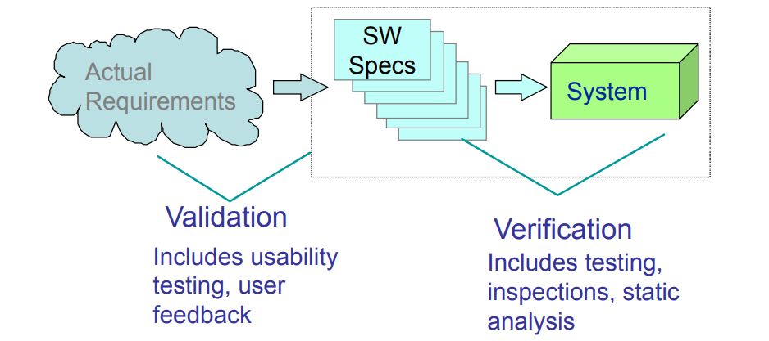
Validation and Verification

Slide 7
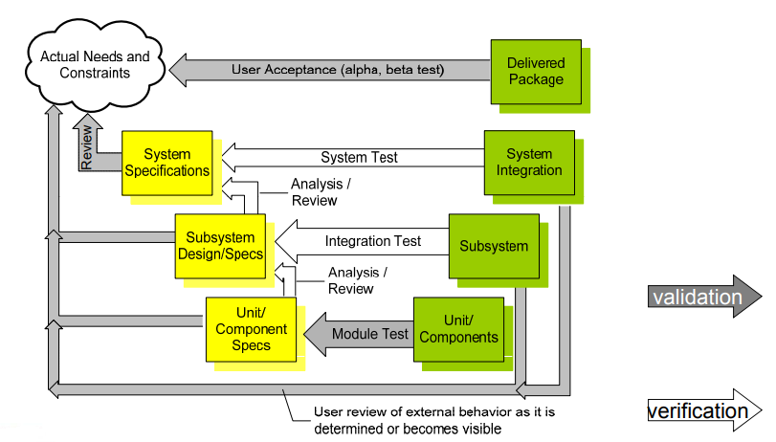
Validation and Verification Activities

Slide 8
Some terminologies
An error
A fault
A failure
Testing attempts to surface failures in our software systems
Debugging attempts to associate failures with faults so they can be removed from the system
Test Cases
Test Suites

Slide 9
Test, Test Case and Test Suite
Test and test case terms are synonyms and may be used interchangeably
A test case consists of inputs given to the program and its expected outputs.
Every test case will have a unique identification number.
During testing, we give selected inputs to the program and note the observed output(s).
Comparison of observed output(s) with the expected output(s)
if they are the same, the test case is successful.
If they are different, that is the failure condition with selected input(s) and this should be recorded properly in order to find the cause of failure.
Notes:
A good test case has a high probability of showing a failure condition. Hence, test case designers should identify weak areas of the program and design test cases
accordingly.

Slide 10
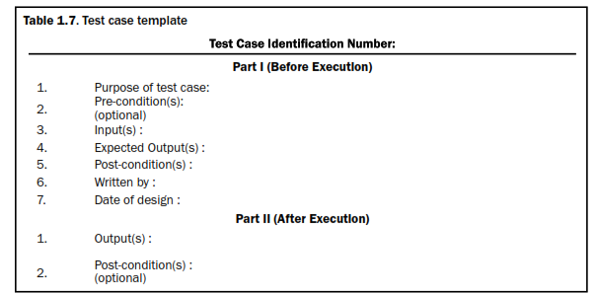
Test case template

Slide 11
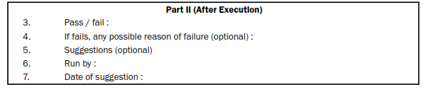
Test case template

Slide 12
Test suite
The set of test cases is called a test suite.
test suite of all test cases,
test suite of all successful test cases and
test suite of all unsuccessful test cases.

Slide 13
Testing the System (I)
Unit Tests
Tests that cover low-level aspects of a system
For each module, does each operation perform as expected
Integration Tests
Tests that check that modules work together in combination
Most projects on schedule until they hit this point
All sorts of hidden assumptions are surfaced when code written by different developers are used in tandem.

Slide 14
Testing the System (II)
System Tests
Tests performed by the developer to ensure that all major functionality has been implemented
Acceptance Tests
Tests performed by the user to check that the delivered system meets their needs

Slide 15
Multi-Level Testing
Once we have code, we can perform three types of tests
Black Box Testing
Does the system behave as predicted by its specification
Grey Box Testing
Having a bit of insight into the architecture of the system, does it behave as predicted by its specification
White Box Testing
Since, we have access to most of the code, lets make sure we are covering all aspects of the code: statements, branches, …

Slide 16
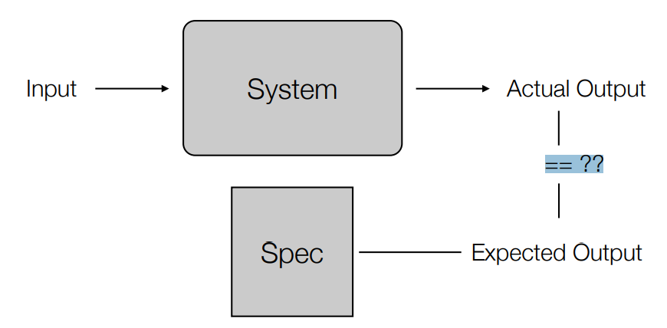
Black Box Testing
A black box test passes input to a system, records the actual output and compares it to the expected output.
if actual output == expected output
TEST PASSED
else
TEST FAILED
Process
Write at least one test case per functional capability
Notes:
?? Note: if you do not have a spec, then any behavior by the system is correct!

Slide 17
grey Box Testing
Use knowledge of system’s architecture to create a more complete set of black box tests
Verifying auditing and logging information
for each function is the system really updating all internal state correctly
System-added information (timestamps, checksums, etc.)
“Looking for Scraps”

Slide 18
White Box Testing
Writing test cases with complete knowledge of code
Format is the same: input, expected output, actual output
• But, now we are looking at
code coverage
proper error handling
proper handling of resources

Slide 19
Static and Dynamic Testing
Static testing refers to testing activities without executing the source code. All verification activities like inspections, walkthroughs, reviews, etc. come under this category of testing.
Dynamic testing refers to executing the source code and seeing how it performs with specific inputs. All validation activities come in this category where execution of the program is essential.

Slide 20
LIMITATIONS OF TESTING
Test everything before giving the software to the customers.
‘EVERYTHING’
Execute every true and false condition
Execute every statement of the program
Execute every condition of a decision node
Execute every possible path
Execute the program with all valid inputs
Execute the program with all invalid inputs
impossible to achieve due to time and resource constraints
Notes:
is very illusive and has many meanings. What do we understand when we say ‘everything’? We
may expect one, two or all of the following when we refer to ‘everything’:

Slide 21
Functional and Structural testing:
Functional testing focus on the external behavior of a software system while viewing the object to be tested as a black-box that prevents us from seeing the contents inside.
Structural testing focus on the internal implementation, while viewing the object to be tested as a white-box that allows us to see the contents inside

Slide 22
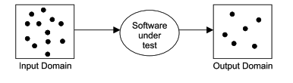
Functional Testing (BBT)
Main intent of software testing is to search of such test cases which may make the software fail.
Functional testing techniques attempt to design those test cases which have a higher probability of making a software fail.
These techniques also attempt to test every possible functionality of the software.
Notes:
Observed output(s) is (are) compared with expected output(s) for selected input(s) with preconditions, if any. The software is treated as a black box.
This black box knowledge is sufficient to design a good number of test cases. Many activities are performed in real life with only black box knowledge like

Slide 23
BOUNDARY VALUE ANALYSIS
Popular functional testing technique that concentrate on input values and design test cases with input values that are on or close to boundary values.
Write a program ‘Square’ which takes ‘x’ as an input and prints the square of ‘x’ as output. The range of ‘x’ is from 1 to 100.
How to test this program???
One possibility is to give all values from 1 to 100 one by one to the program and see the observed behavior.
In boundary value analysis, we select values on or close to boundaries and all input values may have one of the following:
Just above minimum value
Minimum value
Maximum value
Just below maximum value
Nominal (Average) value

Slide 24
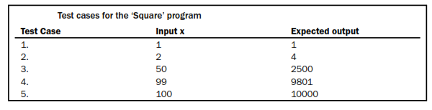

Boundary value analysis for square program
The number of inputs selected by this technique is 4n + 1 where ‘n’ is the number of inputs.
Notes:
Activity : take another example

Slide 25
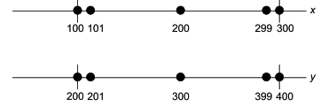
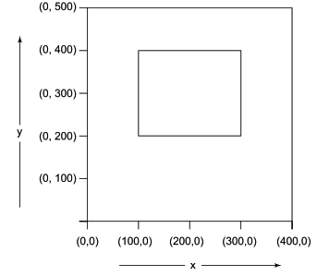
Another example
Consider a program ‘Addition’ with two input values x and y and it gives the addition of x and y as an output. The range of both input values are given as:
100<= x <= 300
200 <= y <= 400

Slide 26
Two Variables:
Let us take the example of two variables, A and B. If we consider all the above combinations with nominal values, then following test cases can be designed:
1. Anom, Bmin
2. Anom, Bmin+
3. Anom, Bmax
4. Anom, Bmax–
5. Amin, Bnom
6. Amin+, Bnom
7. Amax, Bnom
8. Amax–, Bnom
9. Anom, Bnom

Slide 27
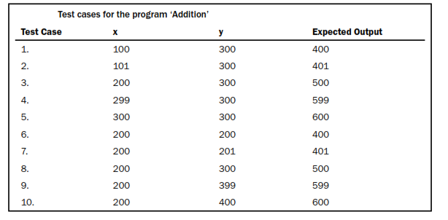

Slide 28
Applicability
This technique is suited to programs in which input values are within ranges or within sets and input values boundaries can be identified from the requirements.
This is equally applicable at the unit, integration, system and acceptance test levels.
Notes:
can significantly reduce the number of test cases and

Slide 29
EQUIVALENCE CLASS TESTING
A large number of test cases are generated for any program. It is neither feasible nor desirable to execute all such test cases.
We may divide input domain into various categories with some relationship and expect that every test case from a category exhibits the same behavior.
If categories are well selected, we may assume that if one representative test case works correctly, others may also give the same results.
Each category is called an equivalence class and this type of testing is known as equivalence class testing.
Notes:
Many test cases do not test any new thing and they just execute the same lines of source code again and again.

Slide 30
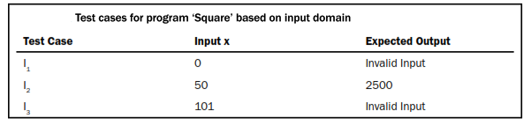

Creation of Equivalence Classes
The entire input domain can be divided into at least two equivalence classes: one containing all valid inputs and the other containing all invalid inputs.
Each equivalence class can further be sub-divided into equivalence classes on which the program is required to behave differently.
Square program

Slide 31
That is all

Slide 32
Concluding remarks
SQA is an umbrella activity which is employed throughout the software lifecycle.
Software quality assurance is very important for your software product or service to succeed in the market and survive up to the customer’s expectations.
There are various activities, standards, and techniques that you need to follow to assure that the deliverable software is of high quality and aligns closely with the business needs

